Slide 1
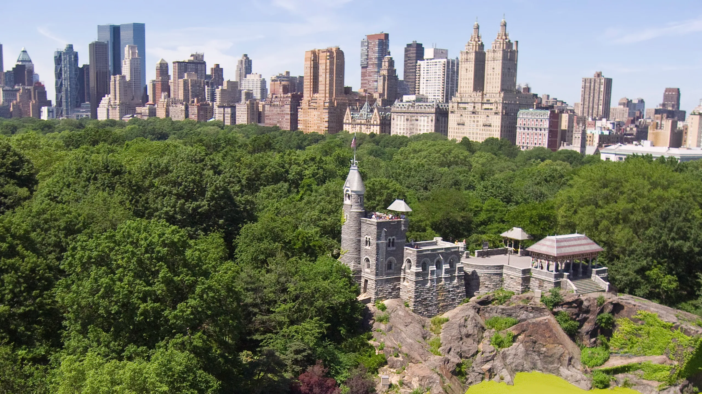
An Analysis of Summer Precipitation & Temperature in Central Park (1972-2022)
Mentor: Kevin Justin Rodriguez
Faculty Advisor: Nir Krakauer
Source: architecturaldigest.com

Slide 2
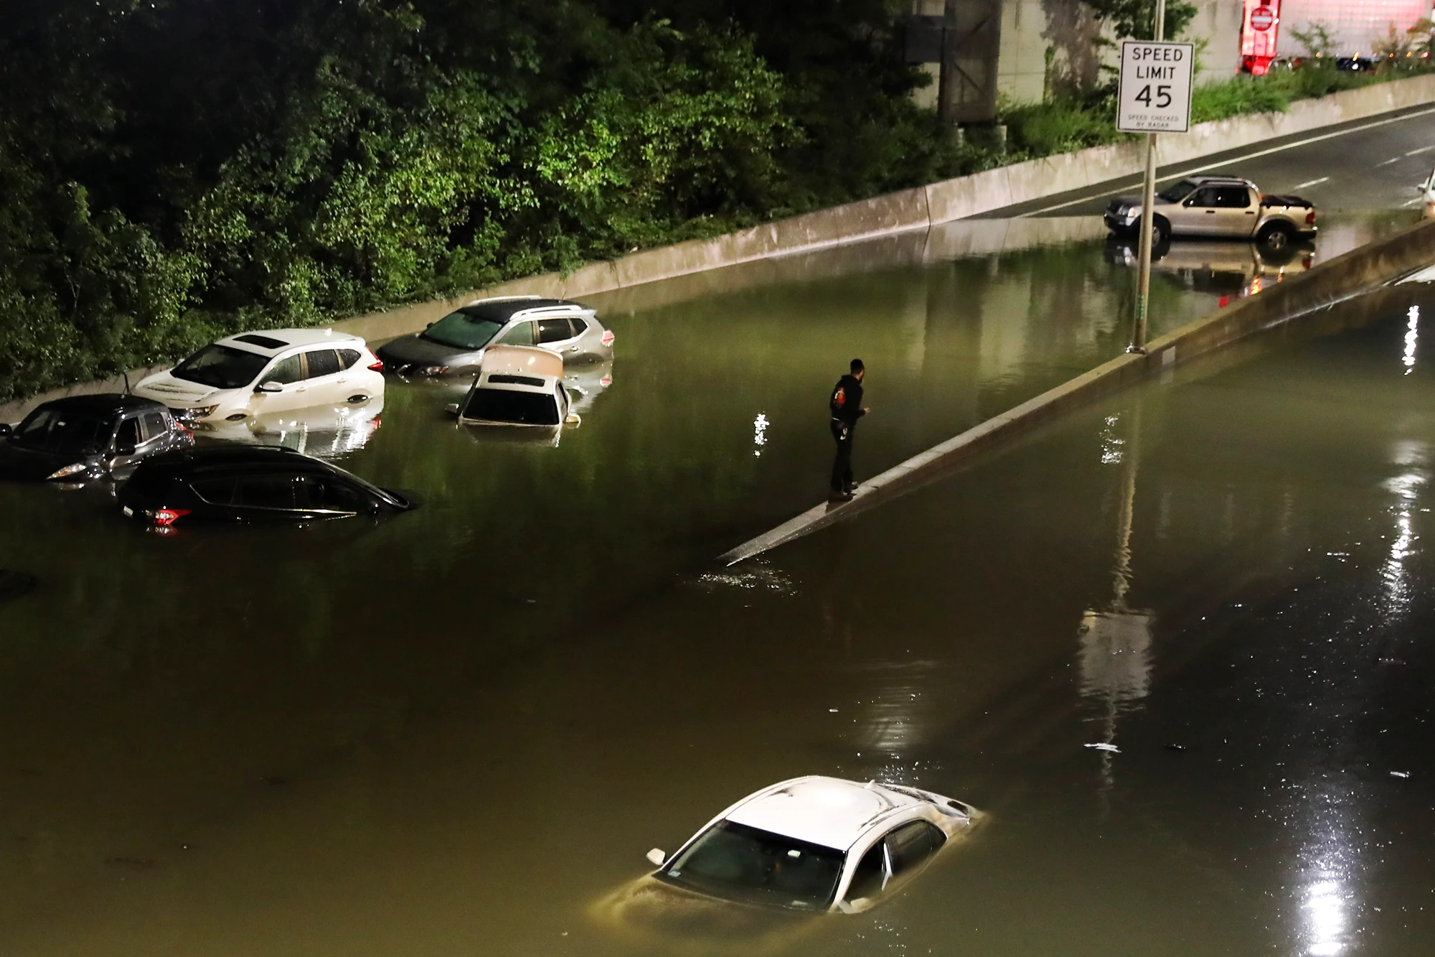
Research Questions
Has there been a change in the frequency and the strength of rainfall events over the 50 year time period?
How much have daily maximum and daily minimum temperatures changed over the time period?
Source: nypost.com

Slide 3
Technique/Methods/Study Sites
Data Source: NCEI (National Center for Environmental Information), National Weather Service
Study Site: Central Park, New York, New York
Weather Station: Belvedere Castle (1920-Present)
Time Period: 01/01/1972 - 01/01/2022 (Dates may vary based on data available)

Slide 4
Computer Skills
Microsoft Excel - Data Analysis, & Graphs
Source: careeranna.com

Slide 5
Research Outcomes
Learn how to obtain meteorological data from a government website (NOAA)
Learn how to make time series plots (Excel)
Understand how much our climate has changed locally
Learn how to present scientific information effectively and concisely

Slide 6
Source: cancollab.com

